Slide 1







DEPLOY WEB APPLICATION WITH DOCKER/AZURE CONTAINER
1
GROUP 07
LECTURER: MSE. TRAN THI DUNG
Student: Nguyen Dai Nghia - 21521182
Pham Hoang Phuc - 21521295
Hoang Gia Bao - 21521848
1

Slide 2
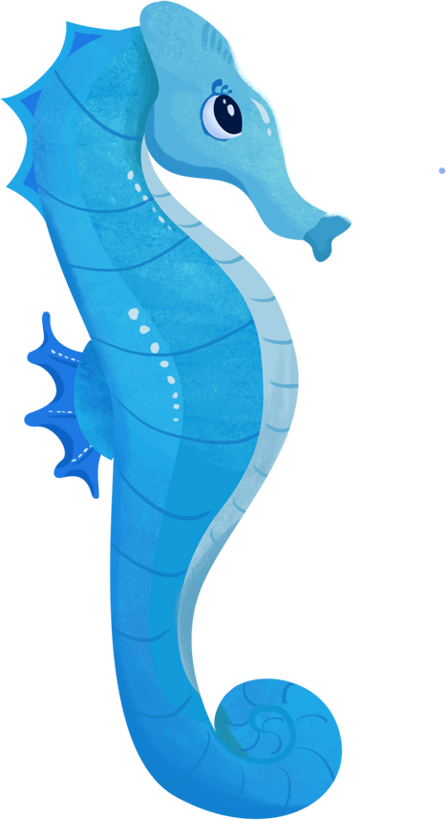

Index
CHAPTER 1: INTRODUCTION
1.1 General information
1.1.1 Docker overview
1.1.2 Azure overview
1.2 Component
1.2.1 Docker
1.3 Operation
CHAPTER 2: IMPLEMENTATION
2

Slide 3





General information
Docker is an open platform for developing, shipping and running applications. It allows applications to be separated from the infrastructure so that software can be delivered quickly.
Microsoft Azure is a cloud computing platform and an online portal to access and manage resources and services provided by Microsoft. It provides a wide range of cloud services, including compute, storage, analytics and networking, to help individuals and organizations build, deploy, and manage applications and services through Microsoft-managed data centers.
3

Slide 4
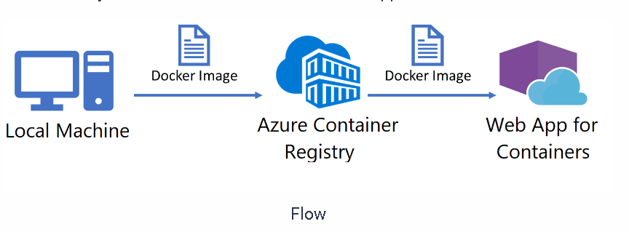
General information
Azure App Service is a fully managed platform-as-a-service (PaaS) offering provided by Microsoft Azure.
4

Slide 5


COMPONENTS
5

Slide 6

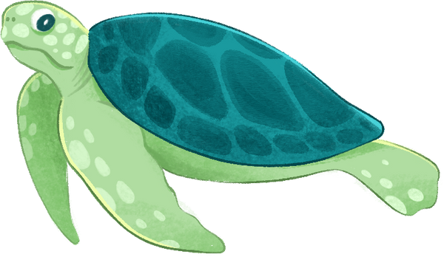

Docker daemon
The Docker daemon operates as a background service on the host machine. It listens for Docker API requests and manages Docker objects.
Docker client
Whenever a user gives commands to Docker, the Docker client sends them to the Docker daemon, which carries them out with Docker API.
6

Slide 7
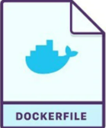
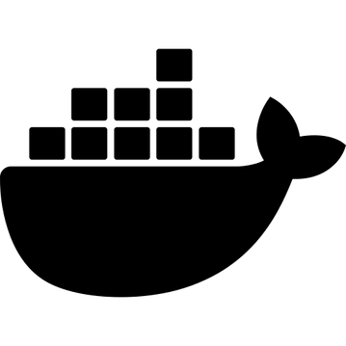
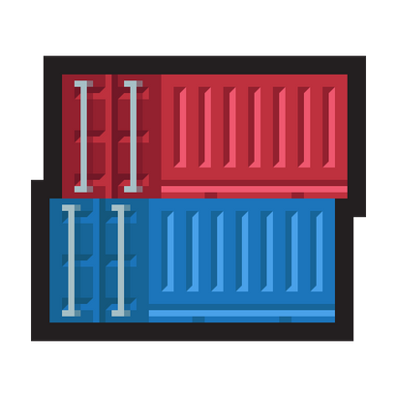
Docker objects
Dockerfile
A text document that contains all the commands needed to build a Docker image.
Docker image
Docker images are read-only templates that include everything needed for running applications.
Docker container
A Docker container is a runnable instance of an image. It runs in an isolated runtime environment, separate from the host machine, and has defined resources.
7

Slide 8
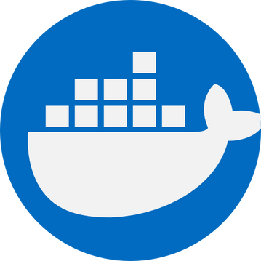

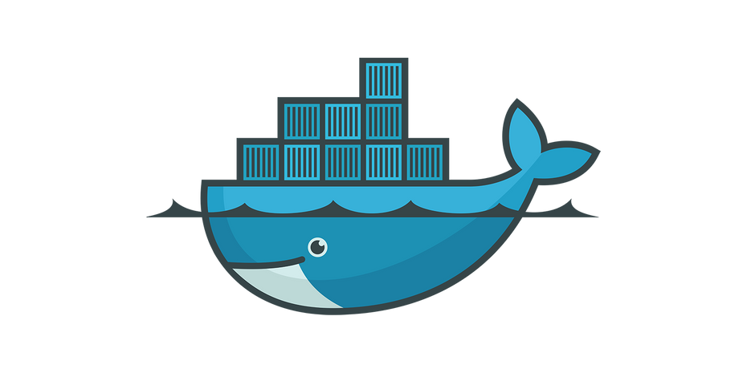

Docker Desktop
Docker Desktop is an application that provides a user-friendly interface and toolset for developers to build and deploy applications using Docker containers on a local machine.
Docker Hub
Docker Hub is a place that stores Docker Images. It is where everyone can push, pull, and share images
8

Slide 9
OPERATION
9

Slide 10

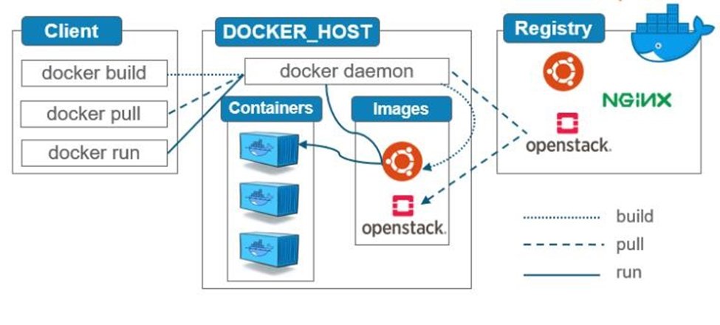

Build a Docker image
It will be sent to the Docker daemon to process the instructions in the Dockerfile and performs the necessary actions to build the image.
10

Slide 11
Build a Docker image
It will be sent to the Docker daemon to process the instructions in the Dockerfile and performs the necessary actions to build the image.
10

Slide 12
Run a container
Docker creates a new container based on the specified image and applies the configuration in that. Then Docker starts the container and initiates the process defined in the image.
11

Slide 13
Pull images from Docker registries
Docker checks if the specified image exists in the registry. If the image is found, Docker initiates the image download process
12

Slide 14
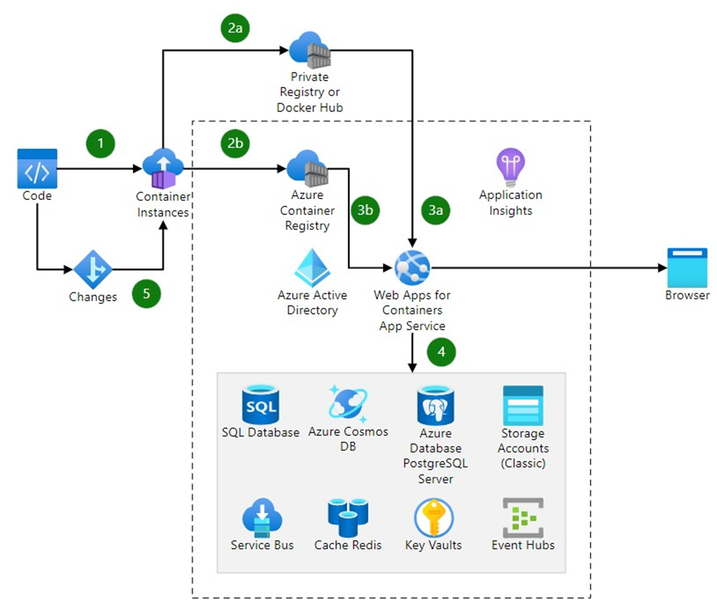

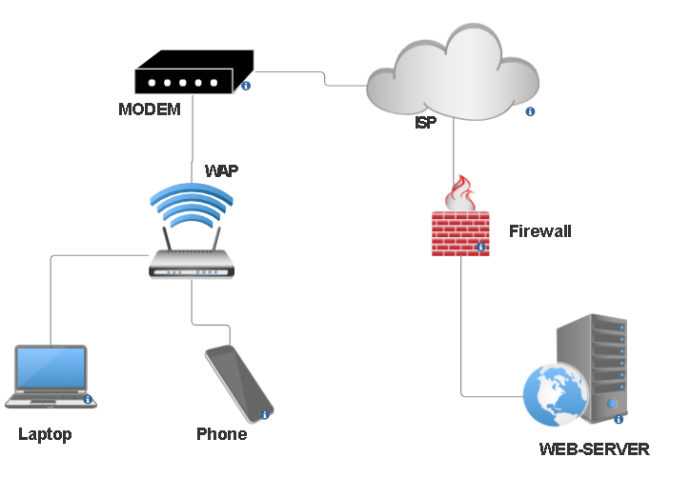
Topology
13

Slide 15
Topology
14

Slide 16
THANK YOU!
15

